Slide 1
Agile Software Engineering Skills
Version Control
Chapter 15
Julian M. Bass

Slide 2
Introduction
Version control solves 3 problems
Creating change records
Storing the changes we make to our evolving software
Sharing and integrating code with others
Version control provides
Source code content management
Searchable change history
Archive and restore code fragments
Shared source code repository enables team working

Slide 3
Contents
Content Management
Source Code History
Source Code Remote Archiving
Source Code Sharing

Slide 4
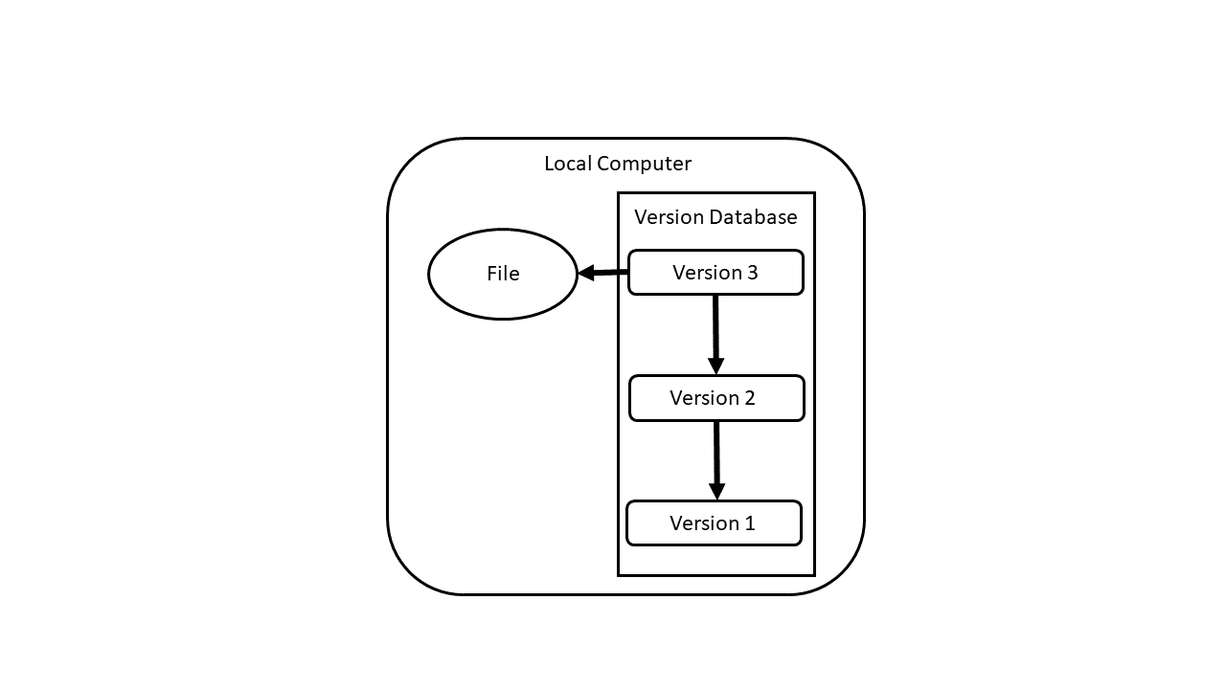
Content Management

Slide 5
Content Management
Version control system records copy of file as changes made
Mainly used for managing software source code files
Can be used for any valuable document
Several version control solutions available, we will discuss “git”

Slide 6
Content Management
Important git commands
C:\>git -- version – check git version installed
C:\>git init – initialise local git repository

Slide 7
Contents
Content Management
Source Code History
Source Code Remote Archiving
Source Code Sharing

Slide 8
Source Code History
Important git commands
C:\>git status – status of files local git folder
C:\>git add – "stage" file local repository version control
C:\>git commit – m "commit message"– commit changes to local git repository

Slide 9
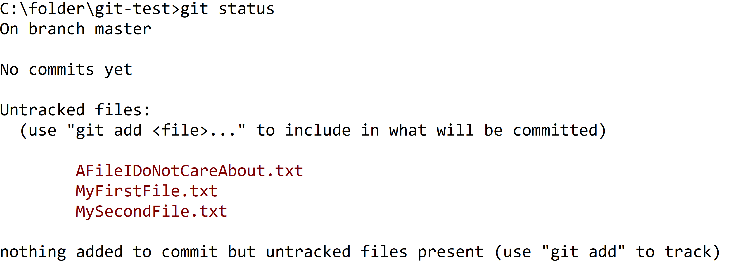
Source Code History
Important git commands
C:\>git status – status of files local git folder

Slide 10
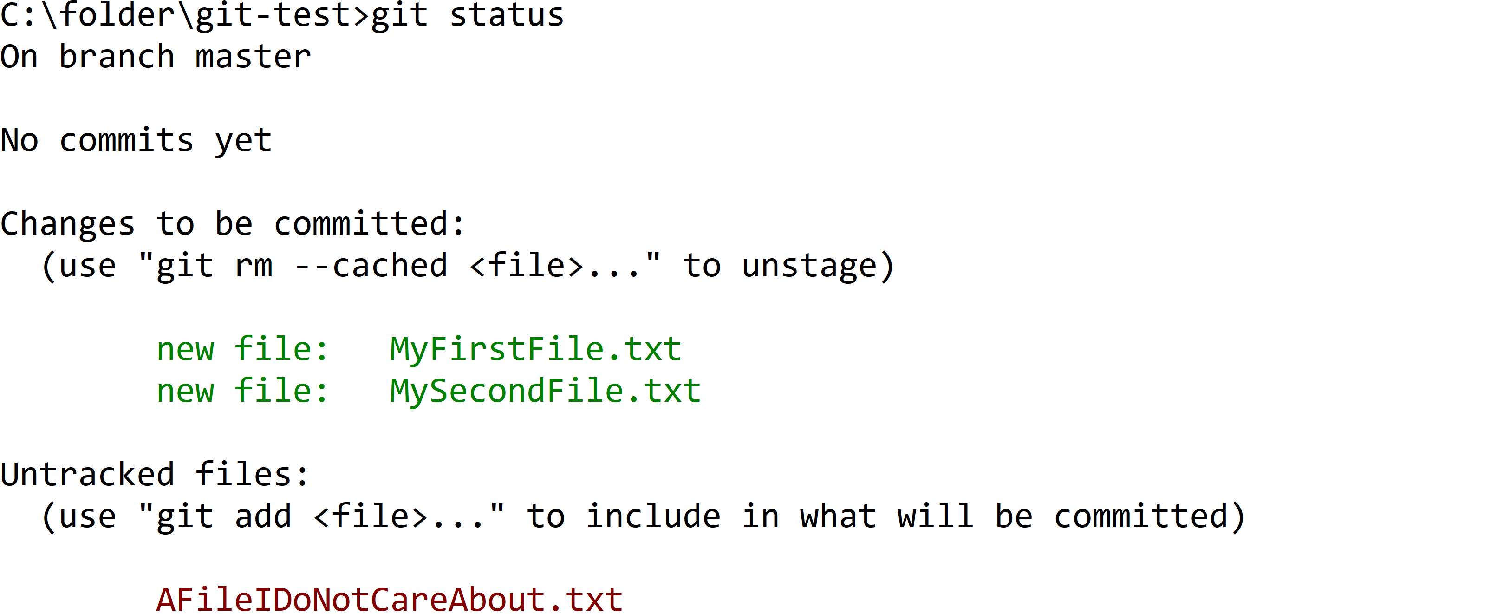
Source Code History
Important git commands
C:\>git add – "stage" file local repository version control

Slide 11
Source Code History
Important git commands
C:\>git commit – m "commit message"– commit changes to local git repository

Slide 12
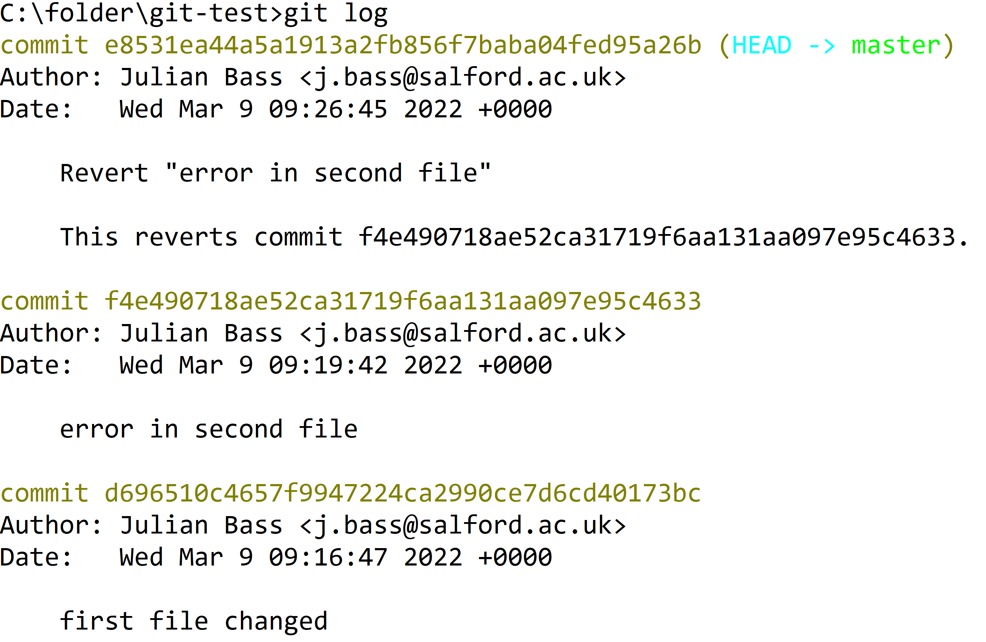
Source Code Remote Archive
Important git commands
C:\>git log – list of commits made to local git repository

Slide 13
Contents
Content Management
Source Code History
Source Code Remote Archiving
Source Code Sharing

Slide 14
Source Code Remote Archive
Important git commands
C:\>git remote add [branch] [server repo] – link local repository to server repository
C:\>git push – copy local commit to server repository
C:\>git remote add origin https://github.com/<your username>/git-test.git
C:\>git push -u origin master

Slide 15
Source Code Remote Archive
Important git commands
C:\>git add –A
C:\>git commit -m "describe changes"
C:\>git push

Slide 16
Contents
Content Management
Source Code History
Source Code Remote Archiving
Source Code Sharing

Slide 17
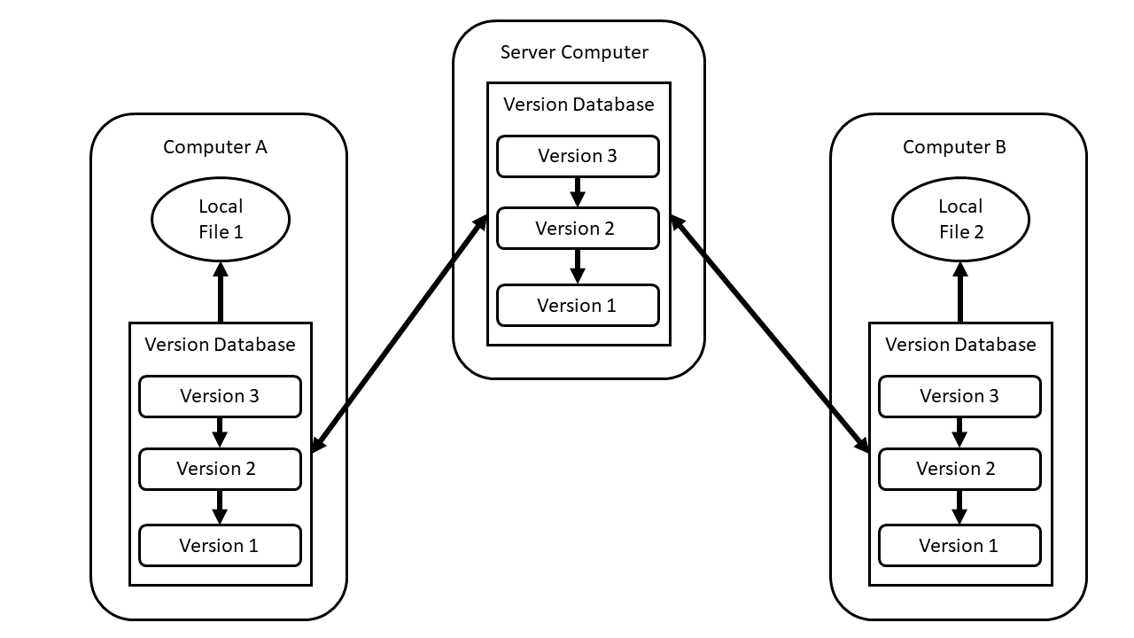
Source Code Sharing
GitHub Server
My colleague
Me

Slide 18
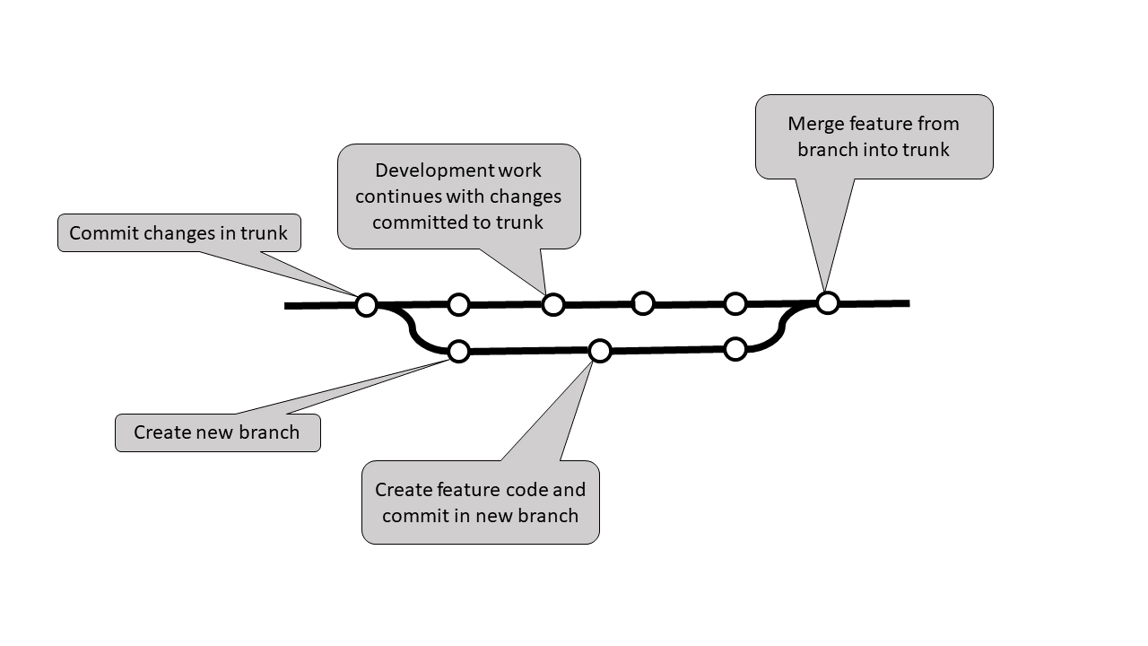
Source Code Sharing

Slide 19
Source Code Sharing
Branches quickly become (overly) complex
Use branches with caution
Some argue better to add new features in main branch

Slide 20
Source Code Sharing
Notice: main branch not same as when feature branch started

Slide 21
Source Code Sharing
Important! process:
Download main (origin, master) branch from server
Merge local branch with main branch
Do this locally
Fix merge conflicts
Only when conflicts fixed push branch back to server

Slide 22
Exercises
Exercises 15.1 and 15.8 encourage creation of a learning journal
Exercise 15.2 Create a Local Git Repository
Exercise 15.3 Create a Remote Git Repository
Exercise 15.4 Create and Merge Git Branches
Exercise 15.5 Sharing Code within a Branch
Exercise 15.6 Sharing Code with Separate Branches Exercise
Exercise 15.7 Sharing Code within a Shared File

Slide 23
Summary
Content management
Local copy of file recording changes made
Source Code History
Ability to revert to any previous version of file
Remote Archiving
Mitigates risk of local data loss
File Sharing
Mechanism for orderly dissemination of source code

