Slide 1
Agile Software Engineering Skills
Testing and Test Automation
Chapter 16
Julian M. Bass

Slide 2
Introduction
Incremental development requires us to test previous increments, each time a new increment is released
Regression testing
Consequently, test automation becomes more attractive

Slide 3
Contents
Test Planning
Test Levels
Testing Techniques
Test Automation

Slide 4
Test Planning
Establish process and resources required for testing
What kinds of testing, when and by whom?
Think about when to schedule testing
Third-party vs. in-house testing

Slide 5
Contents
Test Planning
Test Levels
Testing Techniques
Test Automation

Slide 6
Test Levels
Unit Testing
Isolate and test individual elements (methods, variables)
See java example

Slide 7
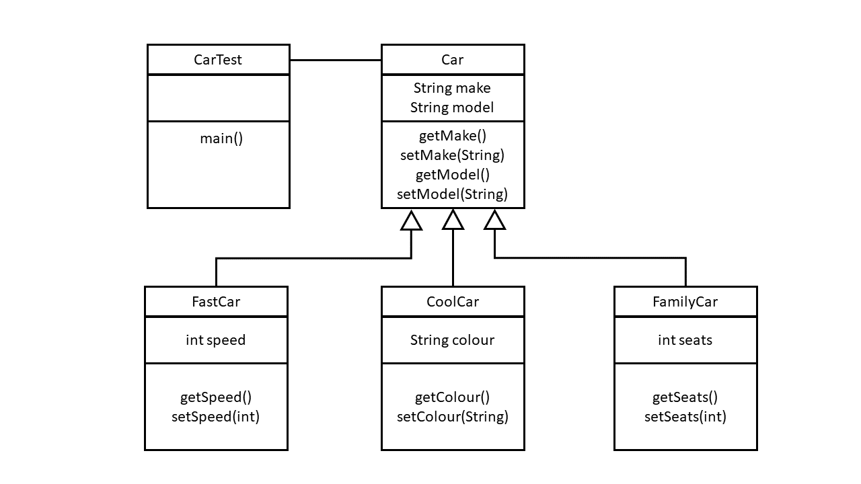
Unit Testing
https://github.com/julianbass/CarTester

Slide 8
Test Levels
Integration Testing
Verify integration of sub-systems
Test interfaces
Use stubs and drivers during development
Stubs fulfil a call and return static values
Drivers make dummy calls to services
For integration testing replace stubs and drivers with code

Slide 9
Test Levels
System Testing
"Technical" testing for system compliance
Test whole, integrated, system
Functional and non-functional requirements tested
Performance testing
Load testing

Slide 10
Test Levels
Acceptance testing
Check that each feature meets needs
Test features in each increment
Use acceptance test results to inform customer demonstrations at the end of each iteration

Slide 11
Contents
Test Planning
Test Levels
Testing Techniques
Test Automation

Slide 12
Testing Techniques
Regression Testing
When new features added, test previous features in increments
Manual regression testing time consuming
Better to automate
Re-run test suites on previous feature sets

Slide 13
Testing Techniques
User Experience Testing
Recruit participants
Participants perform scenarios
Measure scenario completion time, satisfaction, usage mistakes etc.
Use questionnaires or observational measures

Slide 14
Testing Techniques
Performance Testing
Experiments to study system under load
Use tools to load system and automate usage scenarios
Make sure response times acceptable under anticipated loads
Stress testing increases load until performance becomes unacceptable

Slide 15
Testing Techniques
Security Testing
Use code quality test tools
Use specialist security test tools
Schedule security tests before each increment is released
DevSecOps – security testing part of automated CI/CD process

Slide 16
Testing Techniques
A/B Testing
Deploy two alternative versions of functionality
Measure click-throughs or abandonment rates
Select version with best customer outcomes
Normally managed through A/B Testing framework

Slide 17
Contents
Test Planning
Test Levels
Testing Techniques
Test Automation

Slide 18
Test Automation
Instantiate object
Test methods return expected values
public class FastCarTest {
@Test
public void test() {
FastCar fastCar = new FastCar("BMW", "320M", 180);
assertTrue(fastCar.getMake().equals("BMW"));
assertTrue(fastCar.getModel().equals("320M"));
assertTrue( fastCar.getSpeed() == 180);
}
}

Slide 19
Test Automation
assertEquals(boolean expected,boolean actual): to check if two primitives/objects are equal.
assertTrue(boolean condition): to check if a condition is true.
assertFalse(boolean condition): to check if a condition is false.
assertNull(Object obj): to check if an object is null.
assertNotNull(Object obj): to check if an object is not null.

Slide 20
Test Automation
package junit;
import org.junit.runner.RunWith;
import org.junit.runners.Suite;
import org.junit.runners.Suite.SuiteClasses;
@RunWith(Suite.class)
@SuiteClasses({ CarTest.class, FamilyCarTest.class, FastCarTest.class })
public class AllTests {
}

Slide 21
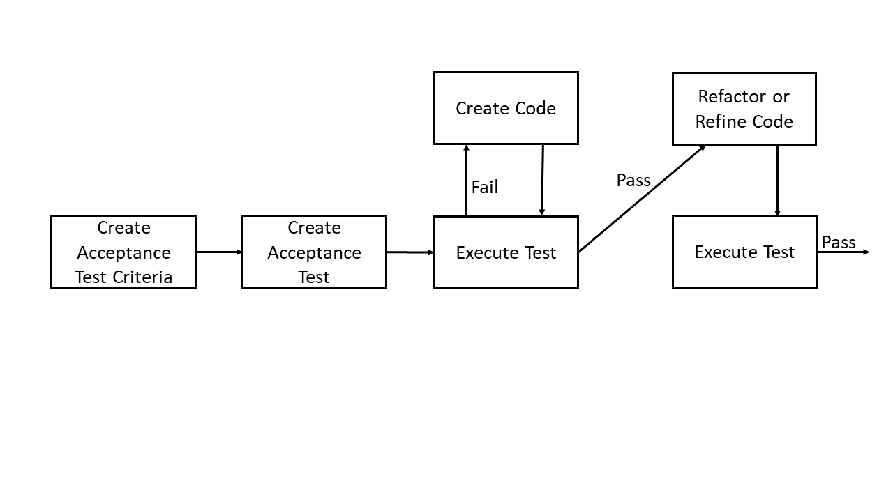
Test Automation
Acceptance Test-driven Development
Write a test
Make it run
Make it right

Slide 22
Test Automation
Behaviour-driven development
Domain specific language
User story-like descriptions translated into test code

Slide 23
Test Automation
Title
A user story title.
Narrative
A brief feature description using the following structure:
As a: the actor who will benefit from the feature;
I want: the feature;
so that: the benefit or value of the feature.
Acceptance criteria
A set of scenarios describing the behaviours of the user
story with the following structure:
Given: the preconditions of the scenario, in one
or more clauses;
When: the event that triggers the scenario;
Then: the expected outcome, in one or more clauses.

Slide 24
Exercises
Exercises 16.1, 16.4 and 16.5 encourage creation of a learning journal
Exercise 16.2 Unit testing
Exercise 16.3 Integration testing

Slide 25
Summary
Testing needed to improve code quality
Automated testing useful during incremental development
Types of testing
Unit
Integration
System
Techniques
User experience
Regression
Performance
Security

